Slide 1



Framework for Customer Behavior Tracking Within Retail Stores
Adham Nagaty 212200212
Nour el Samaa Walid 212200260
Nadder Ragi 212200258
School of Computing and Digital Technology
Supervised by Dr. Ayman Ezzat

Slide 2
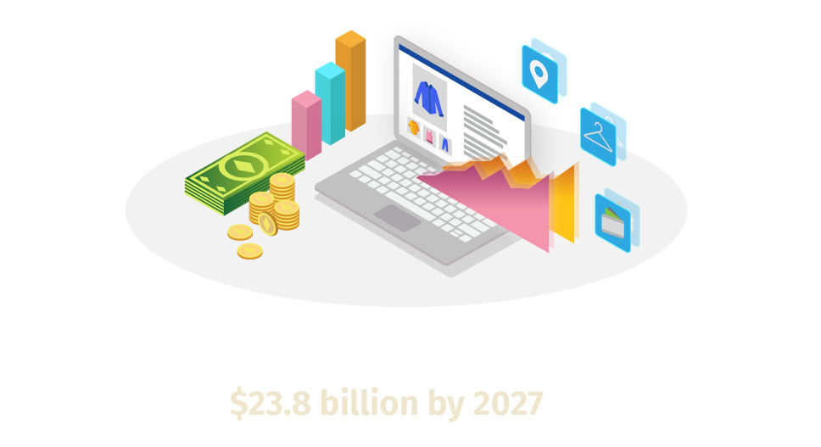
Introduction 1 - Domain Introduction
Customer Retail Analysis:
The study of customer data to understand shopping habits and inform retail decisions.
Human Behavior (within this context):
Analysing customer trajectories and item grabbing tendencies within retail stores. Multi-modal tracking.

Slide 3
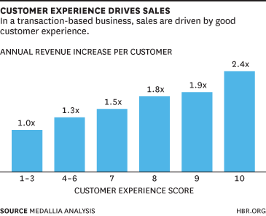
63% spend more
[of shoppers], spend more when faced with a positive, catered in-store experience.
Shopper-Oriented Decision Making - key focus in today’s industry
“State of Consumer Behavior 2022.” Raydiant, 15 Mar. 2022, www.raydiant.com/blog/state-of-consumer-behavior-2022.

Slide 4
Problem Statement
Retail stores are losing customers due to poor understanding of customer behavior and the importance of its analysis.

Slide 5
Introduction 2 - CS-Related Challenges
Scaling system to encompass increasing cameras/branches.
Mapping physical store for accurate tracking.
Learning how to implement caching, load balancing, and scalable architecture to prevent software lag and session overload.
Tracking customers across multiple cameras in-store.
Occlusion of customers, products, and obstacles from camera.

Slide 6
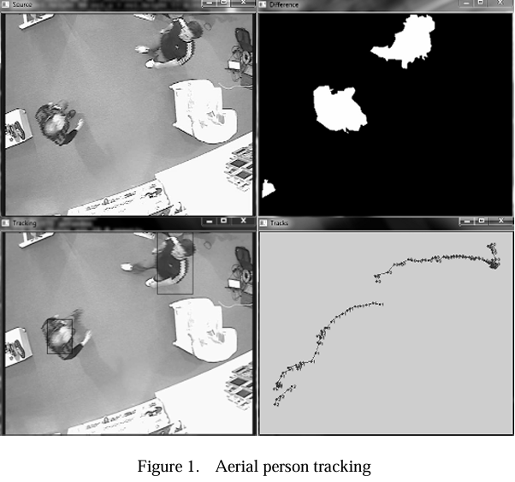
RW 1 - Intelligent Processing of Video Streams for Visual Customer Behavior Analysis
Research aimed at implementing video processing to excel physical retail store performance
Dbscan + Markov models
Faced an issue in the confidence of predicted customer actions
Conclusion: customer trajectories can be predicted and advertisements adapted in real-time to best match customers

Slide 7
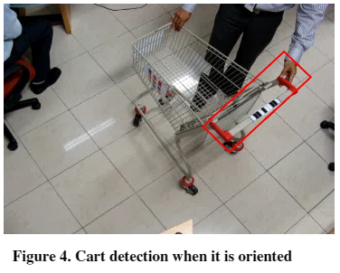
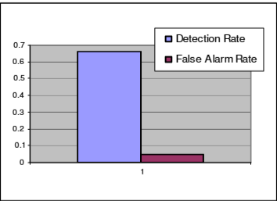
RW 2 - Video Analytics Solution for Tracking Customer Locations in Retail Shopping Malls
Tracked shopping carts through object detection algorithms to extract information on shopper locations
Overcomes issue of cheap hardware and subpar image quality
Placed markers on shopping carts to determine location + direction
Achieved +60% rate of correct predictions
Rai, Harikrishna & Jonna, Kishore & Radha Krishna, Pisipati. (2011). Video analytics solution for tracking customer locations in retail shopping malls. 773-776. 10.1145/2020408.2020533.

Slide 8
Heat-Map Demo

Slide 9
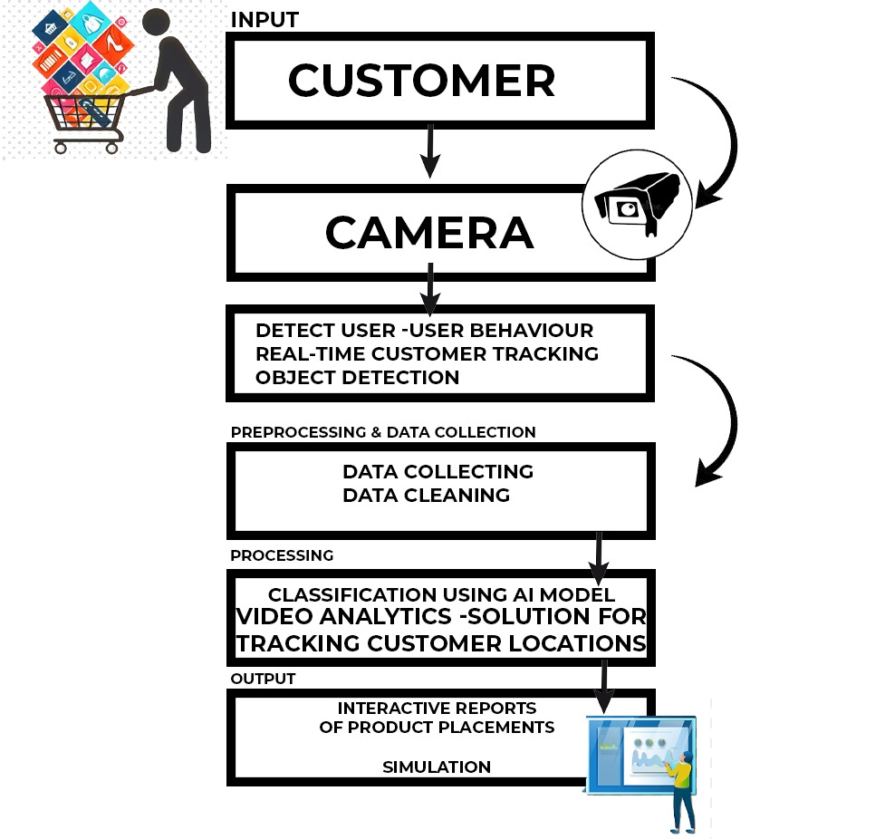
System Overview

